Slide 1

SCHOOL OF INFORMATION AND COMMUNICATIONS TECHNOLOGY
ANALYSIS AND PREDICTION
OF AIR QUALITY DATA
GRADUATION THESIS
Nguyen Duc Hieu – 20158130
Advisor: Ph.D. Nguyen Ba Ngoc
Subject: Information Systems
School: Information and Communications Technology

Slide 2
CONTENTS
AIR QUALITY PREDICTION PROBLEM
THEORETICAL METHODOLOGIES
EXPERIMENTAL IMPLEMENTATION AND EVALUATION

Slide 3
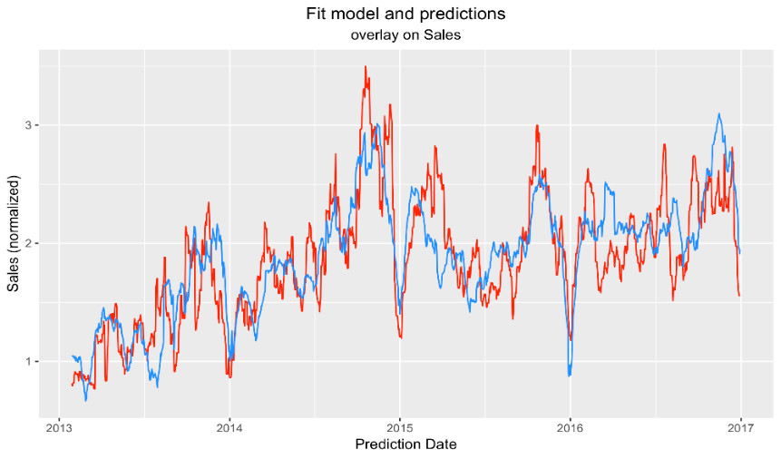
CHAPTER 1. AIR QUALITY PREDICTION PROBLEM
1.1 Introduction to forecasting task
Forecasting is a statistical task in science and business, where it making predictions about the future as accurately as possible, given all of the information available.
A forecasting task usually involves five basic steps:
Problem definition
Gathering data
Preliminary analysis
Choosing and fitting models
Using and evaluating a forecasting model.

Slide 4
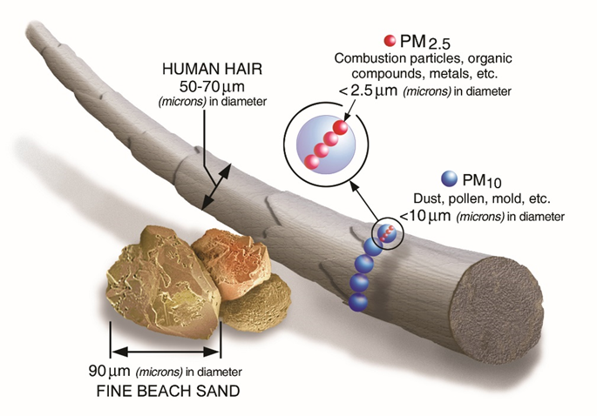
CHAPTER 1. AIR QUALITY PREDICTION PROBLEM
1.2-3 An overview of air quality and air pollutants
Over the last few years, tackling air pollution is an urgent problem in many big cities. Air quality has a huge impact on the quality of living as well as the image of the city.
According to WHO, 5 main substances causing air pollution that affect human health include:
Particulate matter (PM₁₀ and PM_{2.5})
Ozone(O₃)
Oxides of nitrogen (NO_{x})
Sulphur dioxide (SO₂)
Carbon monoxide (CO)
Pollutants can be either from natural sources or discharged in the atmosphere by human activities.

Slide 5
CHAPTER 1. AIR QUALITY PREDICTION PROBLEM
1.4 Air Quality Index (AQI)
The Air Quality Index, or AQI, is a index a system used to warn the public when air pollution is dangerous and forecast their future values. It tracks many air pollutants, from many different sources.
Daily AQI Color | Levels of Concern | Values of Index | Description of Air Quality
Green | Good | 0 to 50 | Air quality is satisfactory, and air pollution poses little or no risk.
Yellow | Moderate | 51 to 100 | Air quality is acceptable. However, there may be a risk for some people, particularly those who are unusually sensitive to air pollution.
Orange | Unhealthy for Sensitive Groups | 101 to 150 | Members of sensitive groups may experience health effects. The general public is less likely to be affected.
Red | Unhealthy | 151 to 200 | Some members of the general public may experience health effects; members of sensitive groups may experience more serious health effects.
Purple | Very Unhealthy | 201 to 300 | Health alert: The risk of health effects is increased for everyone.
Maroon | Hazardous | 301 and higher | Health warning of emergency conditions: everyone is more likely to be affected.

Slide 6
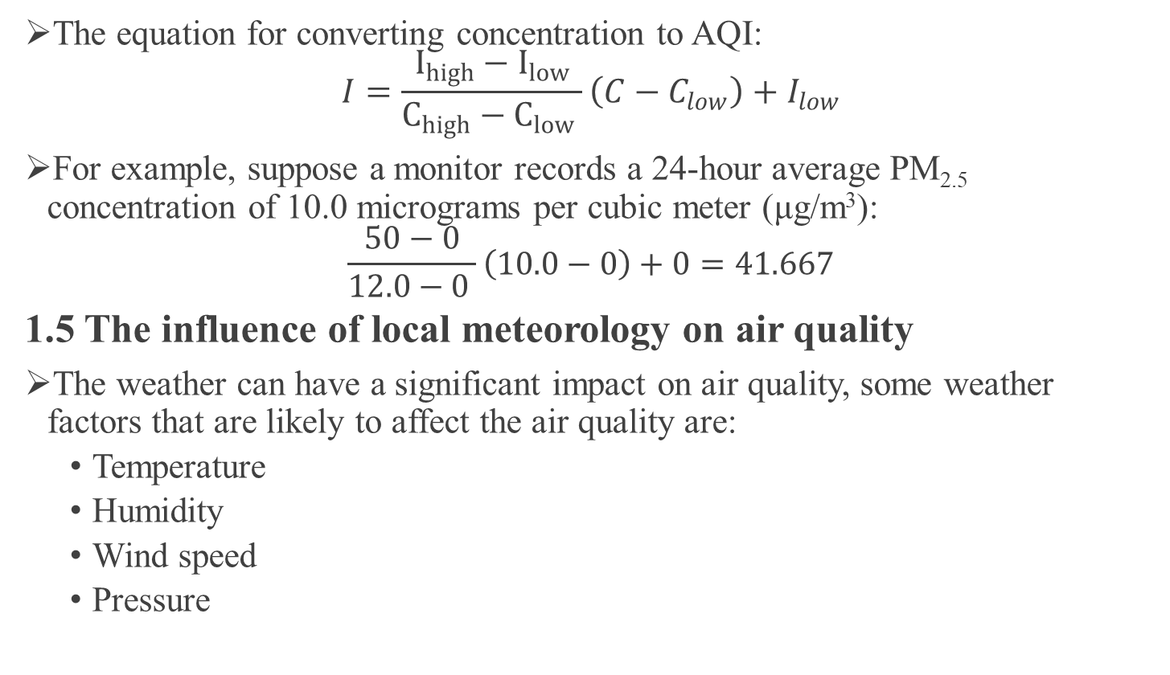
CHAPTER 1. AIR QUALITY PREDICTION PROBLEM
The equation for converting concentration to AQI:
$$I=\frac{I_{high}−I_{low}}{C_{high}−C_{low} }\left(C−C_{low}\right)+I_{low}$$
For example, suppose a monitor records a 24-hour average PM_{2.5} concentration of 10.0 micrograms per cubic meter (μg/m³):
$$\frac{50−0}{12.0−0 }\left(10.0−0\right)+0=41.667$$
1.5 The influence of local meteorology on air quality
The weather can have a significant impact on air quality, some weather factors that are likely to affect the air quality are:
Temperature
Humidity
Wind speed
Pressure

Slide 7
CHAPTER 1. AIR QUALITY PREDICTION PROBLEM
1.6 Some relevant studies on air quality forecasting
Different methodologies have been applied to describe and forecast the dispersion of air pollutants:
Traditional statistical approaches: ordinary least squares (OLS), first-order autoregressive (AR), Autoregressive Integrated Moving Average (ARIMA).
Machine learning and deep learning: Support Vector Regression (SVR), Artificial Neural Networks, Recurrent Neural Networks
In this thesis, 2 models will be used based on the above 2 types of methods:
Vector Autoregression (VAR)
Long Short-Term Memory (LSTM)

Slide 8
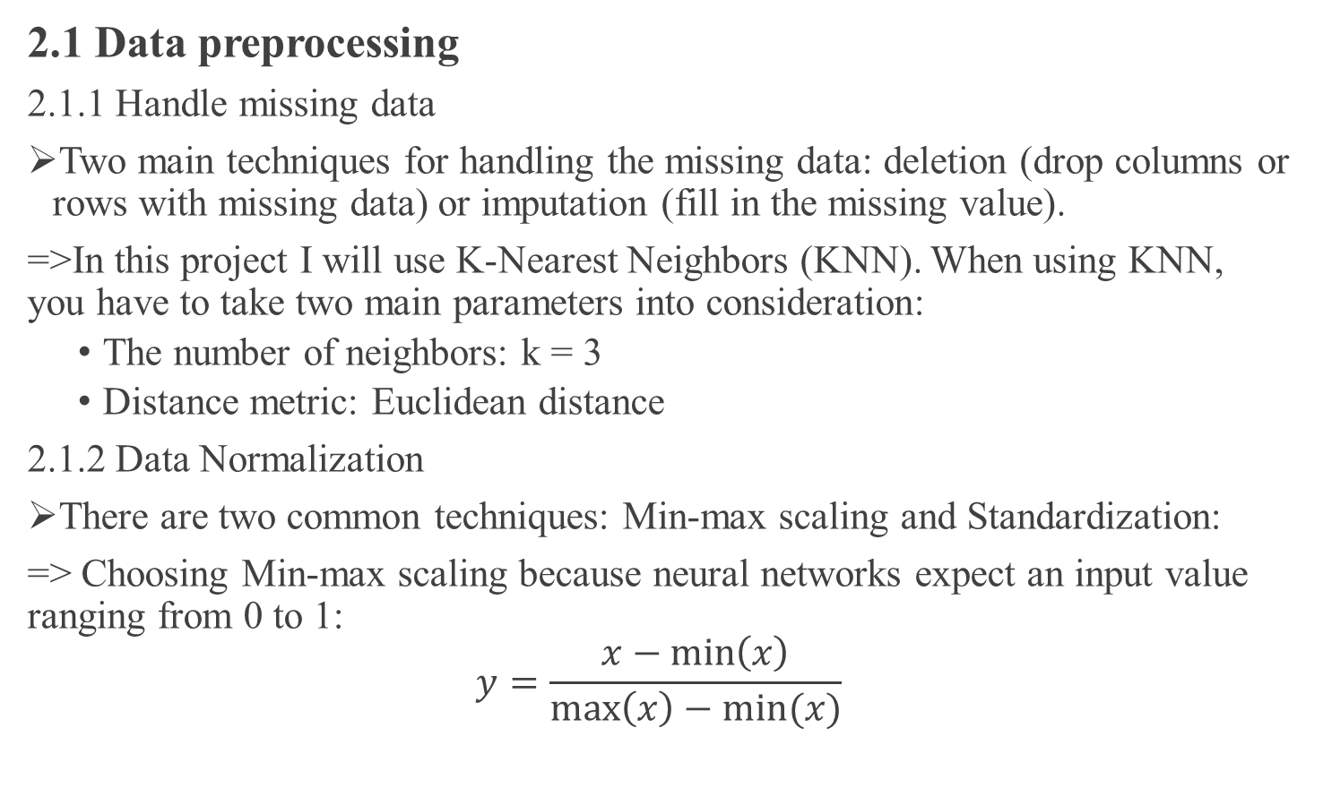
CHAPTER 2. THEORETICAL METHODOLOGIES
2.1 Data preprocessing
2.1.1 Handle missing data
Two main techniques for handling the missing data: deletion (drop columns or rows with missing data) or imputation (fill in the missing value).
=>In this project I will use K-Nearest Neighbors (KNN). When using KNN, you have to take two main parameters into consideration:
The number of neighbors: k = 3
Distance metric: Euclidean distance
2.1.2 Data Normalization
There are two common techniques: Min-max scaling and Standardization:
=> Choosing Min-max scaling because neural networks expect an input value ranging from 0 to 1:
$$y=\frac{x−\min\left(x\right)}{\max\left(x\right)−min⁡(x)}$$

Slide 9
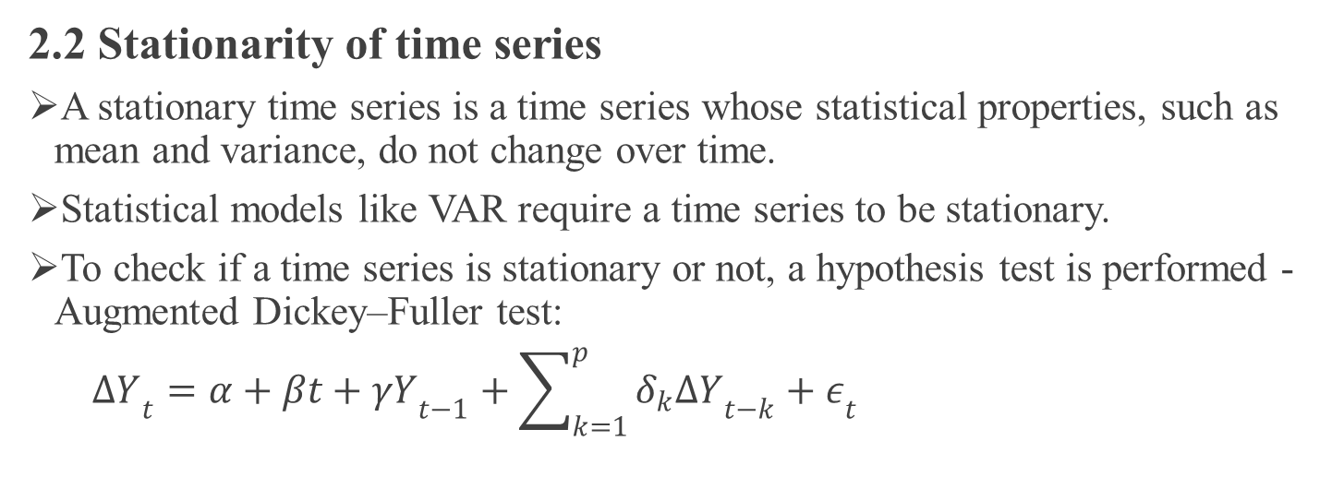
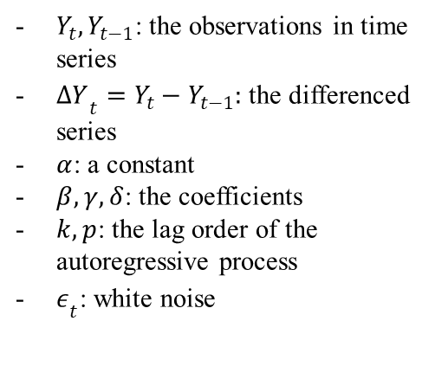
CHAPTER 2. THEORETICAL METHODOLOGIES
2.2 Stationarity of time series
A stationary time series is a time series whose statistical properties, such as mean and variance, do not change over time.
Statistical models like VAR require a time series to be stationary.
To check if a time series is stationary or not, a hypothesis test is performed - Augmented Dickey–Fuller test:
$∆Y­_{t}=α+βt+γY­_{t−1}+\sum_{k=1}^{p}{δ_{k}∆Y­_{t−k}+ε­_{t}}$
$Y_{t}, Y_{t−1}$: the observations in time series
$∆Y­_{t}=Y_{t}−Y_{t−1}:$ the differenced series
$α$: a constant
$β, γ, δ$: the coefficients
$k, p$: the lag order of the autoregressive process
$ε­_{t}$: white noise
The testing hypotheses are:
Null hypothesis (H₀): γ = 0 (non-stationary)
Alternative hypothesis (H_{a}): γ < 0 (stationary)
If p-value < 0.05
=>reject the null hypothesis and vice versa

Slide 10
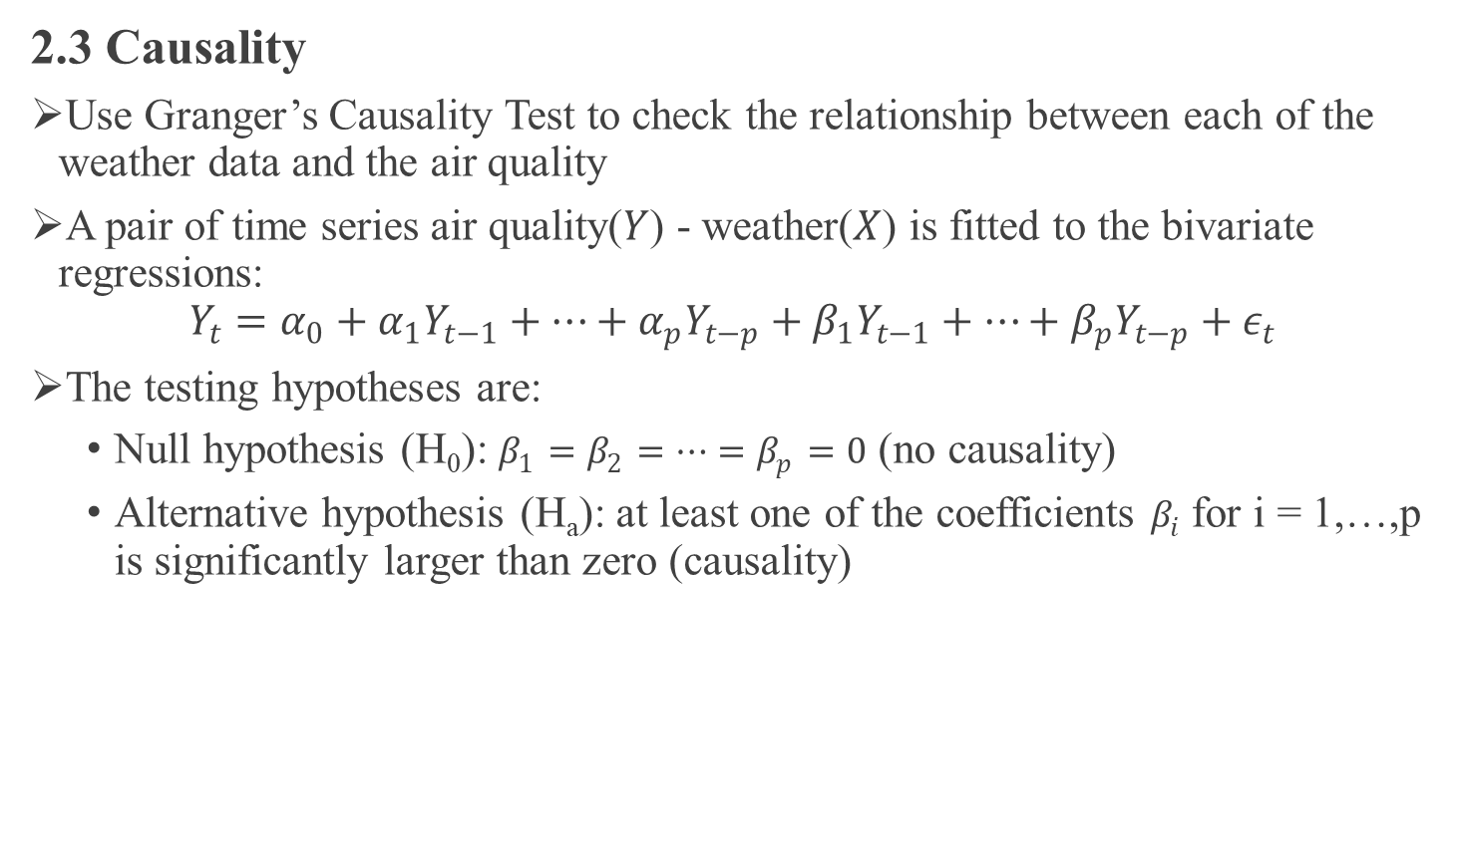
CHAPTER 2. THEORETICAL METHODOLOGIES
2.3 Causality
Use Granger’s Causality Test to check the relationship between each of the weather data and the air quality
A pair of time series air quality($Y$) - weather($X$) is fitted to the bivariate regressions:
$$Y_{t}=α_{0}+α_{1}Y_{t−1}+⋯+α_{p}Y_{t−p}+{β_{1}Y_{t−1}+⋯+β}_{p}Y_{t−p}+ε_{t}$$
The testing hypotheses are:
Null hypothesis (H₀): $β_{1}=β_{2}=⋯=β_{p}=0$ (no causality)
Alternative hypothesis (H_{a}): at least one of the coefficients $β_{i}$ for i = 1,…,p is significantly larger than zero (causality)

Slide 11
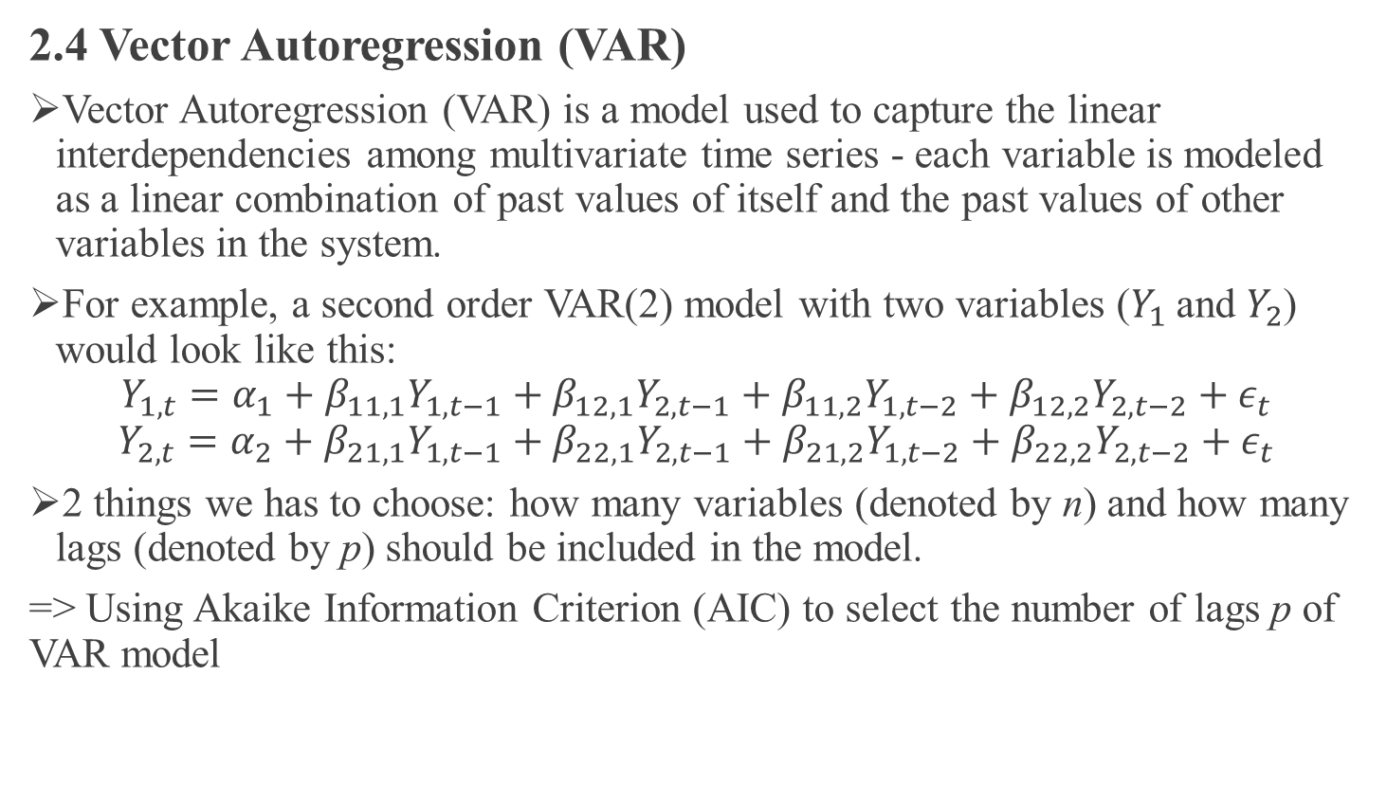
CHAPTER 2. THEORETICAL METHODOLOGIES
2.4 Vector Autoregression (VAR)
Vector Autoregression (VAR) is a model used to capture the linear interdependencies among multivariate time series - each variable is modeled as a linear combination of past values of itself and the past values of other variables in the system.
For example, a second order VAR(2) model with two variables ($Y_{1}$ and $Y_{2}$) would look like this:
$$Y_{1,t}=α_{1}+β_{11,1}Y_{1,t−1}+β_{12,1}Y_{2,t−1}+β_{11,2}Y_{1,t−2}+β_{12,2}Y_{2,t−2}+ε_{t}$$
$$Y_{2,t}=α_{2}+β_{21,1}Y_{1,t−1}+β_{22,1}Y_{2,t−1}+β_{21,2}Y_{1,t−2}+β_{22,2}Y_{2,t−2}+ε_{t}$$
2 things we has to choose: how many variables (denoted by n) and how many lags (denoted by p) should be included in the model.
=> Using Akaike Information Criterion (AIC) to select the number of lags p of VAR model

Slide 12
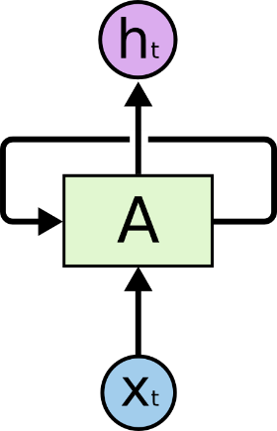
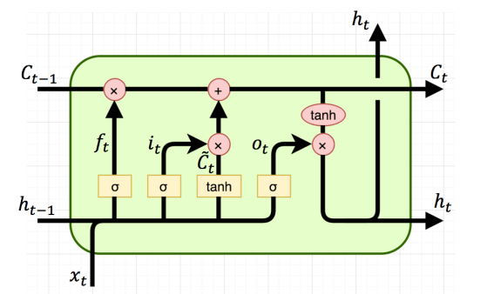
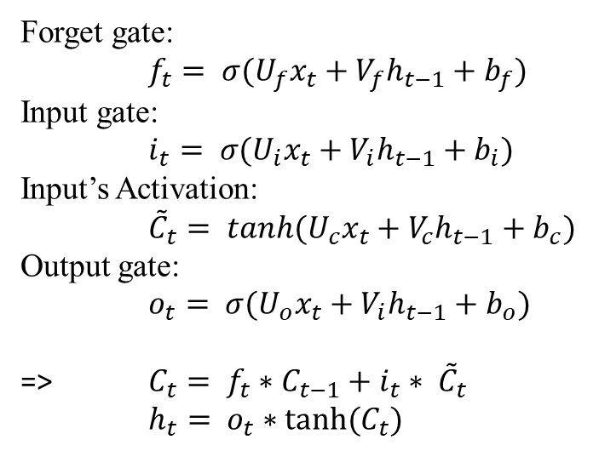
CHAPTER 2. THEORETICAL METHODOLOGIES
LSTM is a special kind of Recurrent Neural Network
Designed to solve the Short-Term memory problem
Instead of having a single neural network layer, there are four layer interacting in a very special way:
Forget gate:
$f_{t}= σ(U_{f}x_{t}+V_{f}h_{t−1}+b_{f})$
Input gate:
$i_{t}= σ(U_{i}x_{t}+V_{i}h_{t−1}+b_{i})$
Input’s Activation:
${\tilde{C}}_{t}= tanh(U_{c}x_{t}+V_{c}h_{t−1}+b_{c})$
Output gate:
$o_{t}= σ(U_{o}x_{t}+V_{i}h_{t−1}+b_{o})$
=> $C_{t}= f_{t}∗C_{t−1}+i_{t}∗ {\tilde{C}}_{t}$
$h_{t}= o_{t}∗tanh(C_{t})$

Slide 13
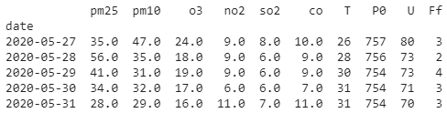
CHAPTER 3. EXPERIMENTAL IMPLEMENTATION AND EVALUATION
3.1 Data preparation
The dataset I chose for this experiment is the daily historical dataset of AQI in Hanoi for the six individual air pollutants PM_{2.5}, PM₁₀, O₃, NO₂, SO₂ and CO from 03-01-2016 to 31-05-2020.
Weather observations from the nearest airport weather station includes the following data:
Air temperature T (°C)
Atmospheric pressure P0 (mmHg)
Relative humidity U (%)
Mean wind speed Ff (meters per second – m/s)

Slide 14
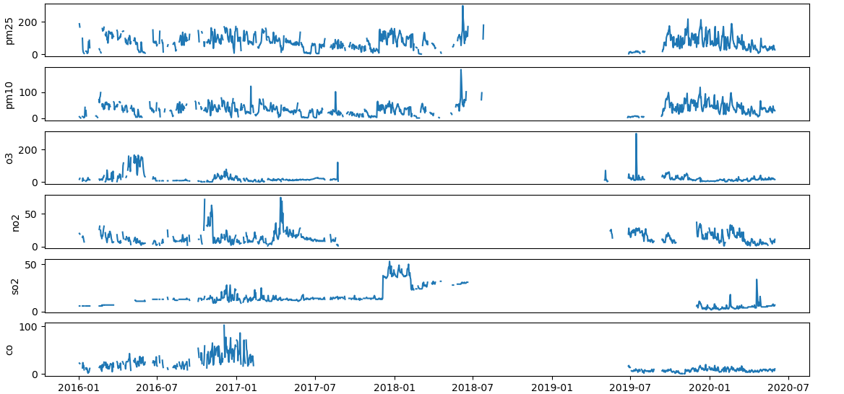
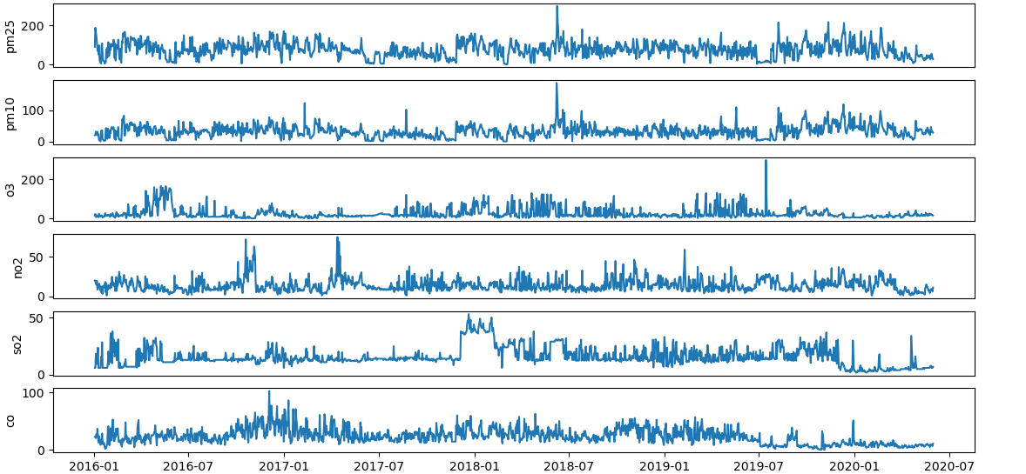
CHAPTER 3. EXPERIMENTAL IMPLEMENTATION AND EVALUATION
3.2 Data preprocessing

Slide 15
CHAPTER 3. EXPERIMENTAL IMPLEMENTATION AND EVALUATION
3.3 Testing stationarity
=> All time series is stationary (test statistics < critical value => p-value < 0.05)
3.4 Testing Granger’s Causality
=> Almost all the weather time series in the dataset are causing the pollutants, except for Wind speed is not causing O₃ (0.3767)
 | PM_{2.5} | PM₁₀ | O₃ | NO₂ | SO₂ | CO
Test Statistic | -7.333 | -7.599 | -4.394 | -4.991 | -3.869 | -3.453
Critical value 5% | -2.864 | -2.864 | -2.864 | -2.864 | -2.864 | -2.864
P value | 0.0 | 0.0 | 0.0 | 0.0 | 0.002 | 0.009
Result | Stationary | Stationary | Stationary | Stationary | Stationary | Stationary
 | Temperature | Pressure | Humidity | Wind speed
PM_{2.5} | 0.0000 | 0.0000 | 0.0000 | 0.0000
PM₁₀ | 0.0001 | 0.0000 | 0.0000 | 0.0162
O₃ | 0.0348 | 0.0043 | 0.0167 | 0.3767
NO₂ | 0.0261 | 0.0004 | 0.0000 | 0.0311
SO₂ | 0.0355 | 0.0085 | 0.0001 | 0.0114
CO | 0.0005 | 0.0000 | 0.0000 | 0.0410

Slide 16
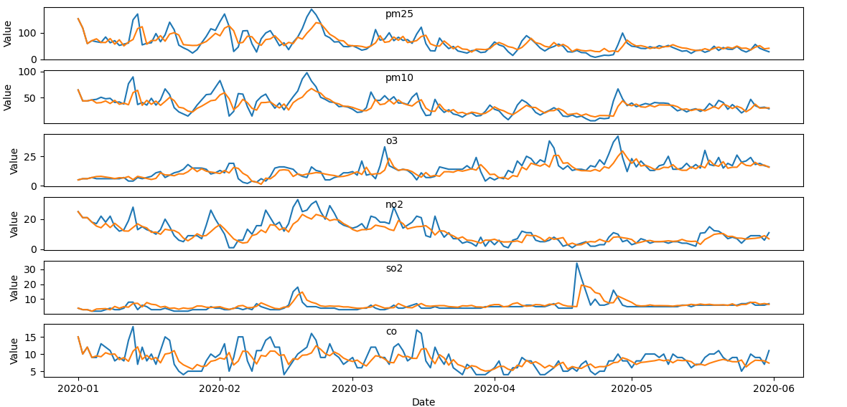

CHAPTER 3. EXPERIMENTAL IMPLEMENTATION AND EVALUATION
3.5 Vector Autoregression (VAR)
The lag order of the VAR model is 4 based on AIC:
$${PM25}_{t}=α_{1}+β_{11}{PM25}_{t−1}+β_{12}T_{t−1}+β_{13}{P0}_{t−1}+β_{14}U_{t−1}+β_{15}{Ff}_{t−1}$$
$$+⋯+β_{41}{PM25}_{t−4}+β_{42}T_{t−4}+β_{43}{P0}_{t−4}{+β}_{44}U_{t−4}+β_{45}{Ff}_{t−4}+ε_{t}$$
Predict the next 1 day AQI and compare to the actual value using the test set (Blue line represents the actual time series, red line represents the predicted):

Slide 17
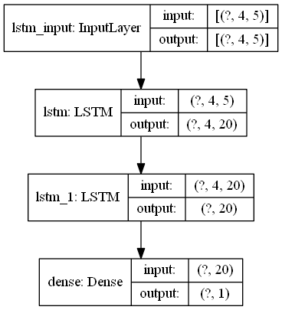
CHAPTER 3. EXPERIMENTAL IMPLEMENTATION AND EVALUATION
3.6 Long Short-Term Memory (LSTM)
Before we can train LSTM, we need to model the data in a supervised form, the past values as features and future values as labels :
The LSTM model has 2 hidden layers, an LSTM layer with 20 neurons above provides a sequence output to the LSTM layer with 20 neurons below:
PM_{2.5}(t-4) | T(t-4) | P0(t-4) | U(t-4) | Ff(t-4) | PM_{2.5}(t)
PM_{2.5}(t-3) | T(t-3) | P0(t-3) | U(t-3) | Ff(t-3)
PM_{2.5}(t-2) | T(t-2) | P0(t-2) | U(t-2) | Ff(t-2)
PM_{2.5}(t-1) | T(t-1) | P0(t-1) | U(t-1) | Ff(t-1)

Slide 18
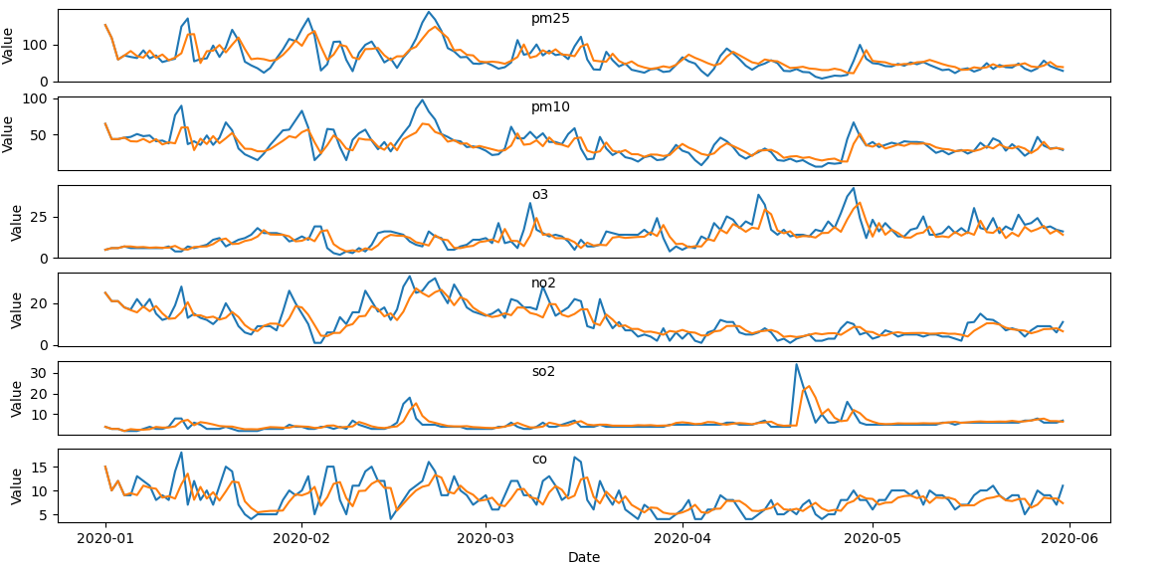
CHAPTER 3. EXPERIMENTAL IMPLEMENTATION AND EVALUATION
Predict the next 1 day AQI and compare to the actual value using the test set:

Slide 19
CHAPTER 3. EXPERIMENTAL IMPLEMENTATION AND EVALUATION
The MAE loss in the evaluate phase is summarized in the following table:
In general, for the 1-day forecast problem, both models can capture the pattern of the time series quite well and correctly forecast the trend of the series.
LSTM model gives slightly better results than VAR model.
 | VAR(1-day) | LSTM(1-day) | VAR(3-day) | LSTM(3-day)
PM_{2.5} | 16.782 | 15.402 | 20.261 | 18.748
PM₁₀ | 8.647 | 8.528 | 10.404 | 10.631
O₃ | 3.779 | 3.753 | 4.231 | 4.542
NO₂ | 3.324 | 3.112 | 3.814 | 3.562
SO₂ | 1.79 | 1.268 | 2.215 | 1.62
CO | 2.003 | 1.938 | 2.126 | 2.111

Slide 20
CHAPTER 4. CONCLUSION
Main difficulty:
Finding data for the experimental implementation: The dataset collected in this thesis is still lacking and have many missing data points.
Developing the LSTM network: The model has quite a lot of different architectures and hyperparameters, so training all these different variants is time consuming.
Direction for further research:
Collect furthermore datasets
Choosing better algorithms

Slide 21

Thank you for listening to my presentation!
Q&A

